Slide 1

Introduction to Artificial Intelligence Group 1 Week 8
Dr. Juan Carlos Rojas
Juan-Carlos.Rojas@ttu.edu

Slide 2
Schedule
Date | Class | HW Assigned | HW Due
May 18 | Class 1 | HW1
May 25 | Class 2 | HW2 | HW1
June 1 | Class 3 | HW3 | HW2
June 8 | Class 4 | HW4 | HW3
June 15 | No class
June 22 | Class 5 | HW5 | HW4
June 29 | Class 6 | HW6 | HW5
July 6 | Class 7 | HW7 | HW6
July 13 | Class 8 |  | HW7

Slide 3
Agenda for Week 8
Theory
Unsupervised learning
Dimensionality reduction
PCA
t-SNA
Clustering
k-Means
Practice
Dimensionality reduction and clustering of:
Pineapple image
MNIST
Vehicle database
Credit card database

Slide 4
Unsupervised Learning

Slide 5
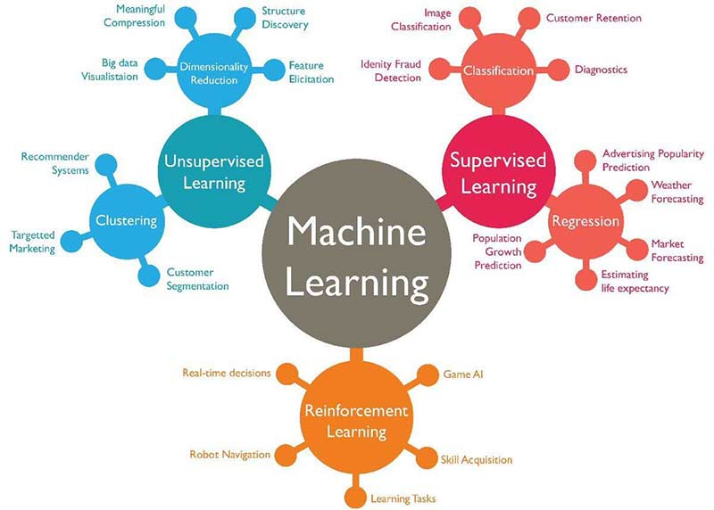

Slide 6
Unsupervised Learning
Infers patterns from unlabeled data
The main methods are:
Dimensionality reduction
For visualization of high-dimensional data
Clustering
Automated labeling of data samples
Based on similarity measures

Slide 7
Dimensionality Reduction
Reducing high-dimensional data into 2 or 3 dimensions
Useful for visualization of data groupings
Helps identify the number of clusters present
Can help to identify outliers
Can be used as a pre-processing step before clustering
The two most common approaches are:
Principal Component Analysis (PCA)
t-Distributed Stochastic Neighbor Embedding (t-SNE)

Slide 8
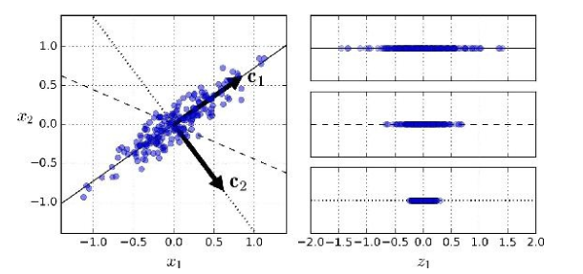
Principal Component Analysis
Looks for linear projections that maximize the variance
Maximal variance implies that more information is preserved
Uses eigen-value decomposition of the covariance matrix to compute the principal components

Slide 9
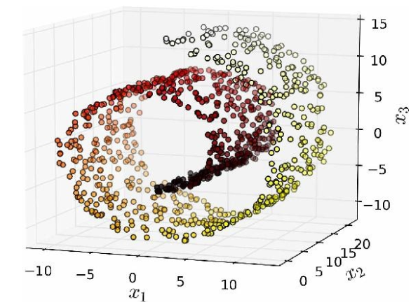
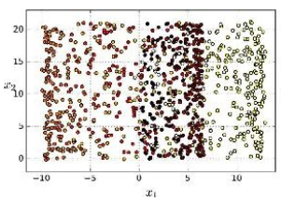
Principal Component Analysis
Advantages of PCA
It is very fast
Creates good separation of data
Disadvantages of PCA
Clusters are spread-out, are hard to visualize
Cannot handle manifold (rolled-up) structures

Slide 10
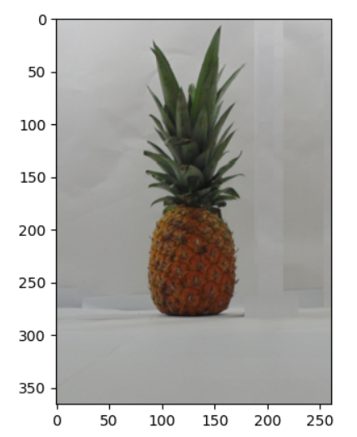
PCA Reduction of Pixel Colors
Let’s use PCA to reduce the space of pixel colors from 3 dimensions (R,G,B) to two
This example image contains 3 main color regions
Yellow (fruit)
Green (crown)
White (background)

Slide 11
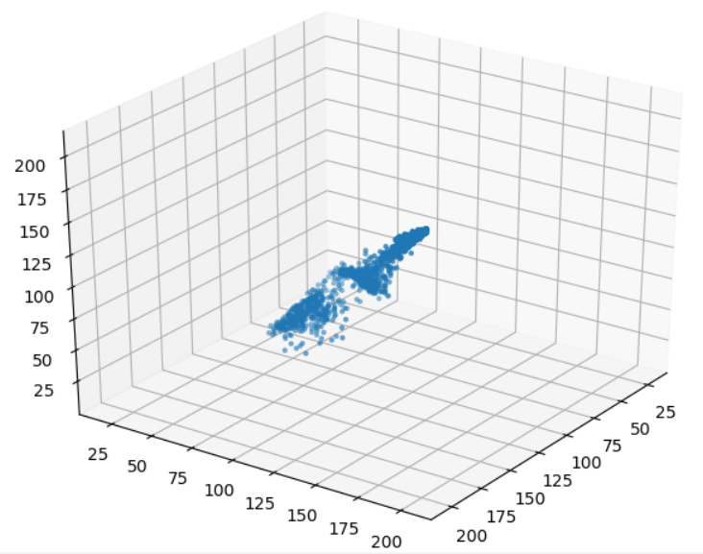
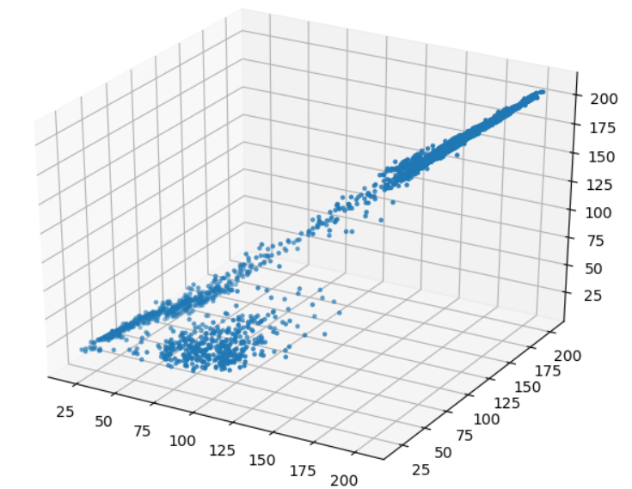
PCA Reduction of Pixel Colors
First we visualize the pixel colors in 3D space
See Pineapple_Explore_1.py
There are many possible projections from 3D space into 2 dimensions
By rotating the 3D graph
Some with more variance than others

Slide 12
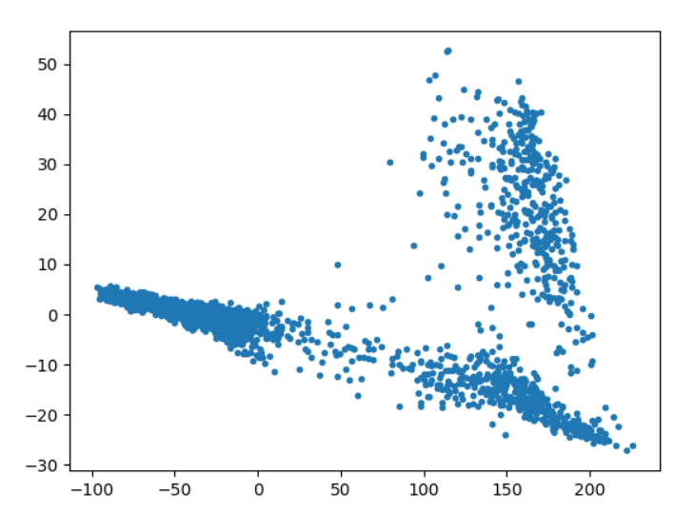
PCA Reduction of Pixel Colors
We can use Scikit-Learn to compute the PCA projection into 2D space that maximizes variance
See Pineapple_PCA_1.py

Slide 13
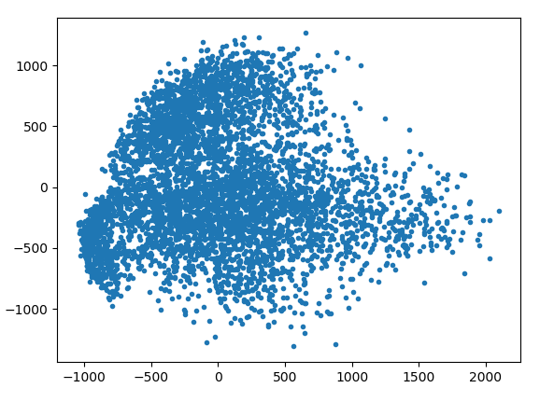
PCA Reduction of MNIST
Imagine we didn’t know the labels for MNIST, or how many clusters the data represented
Could we use PCA to observe the clustering behavior?
The input images have 784 dimensions (one per pixel)
These need to be reduced to 2 by PCA
See MNIST_PCA_1.py
The clusters are not very obvious without knowing the labels

Slide 14
t-Distributed Stochastic Neighbor Embedding (t-SNE)
Non-linear dimensionality reduction technique
Maps probability distributions in high-dimensional space to probability distributions in low-dimensional space
Minimizes the divergence between the distributions
Similar points are modeled close to each other
Dissimilar points are modeled far from each other
It is an expensive technique
You will need to limit the computation to a subset of the data (~5-10k points)
You can also look for a faster implementation than that in sklearn

Slide 15
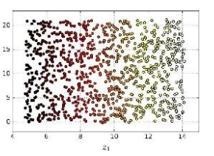
t-Distributed Stochastic Neighbor Embedding (t-SNE)
Advantages of t-SNE
Preserves clustering well
Great for visualization
Can handle manifold structures
Disadvantages of t-SNE
It is expensive to compute

Slide 16
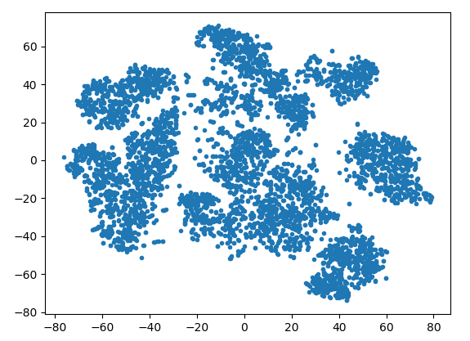
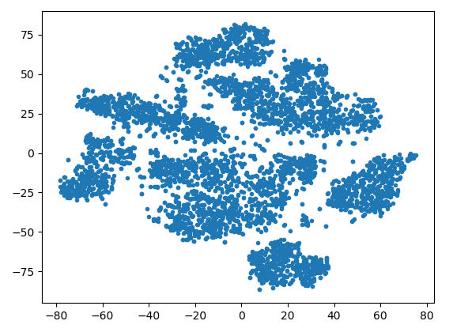
t-SNE Reduction of MNIST
See MNIST_tSNE_1.py
We may get different results in different runs due to the random initialization points of t-SNE
The 10 clusters can be observed (kind of)

Slide 17
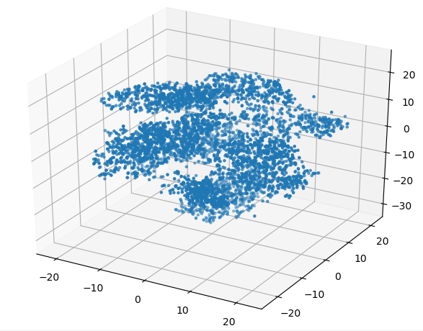
3D Visualization of t-SNE Reduction
We can use 3D plots to view the dimensionality reduction results into 3 dimensions
Helps separate the clusters more
See MNIST_tSNE_2.py
Or MNIST_tSNE_2b.py

Slide 18
Dimensionality Reduction of Vehicle Price Dataset
In order to utilize categorical inputs, they need to be one-hot encoded
Also, make sure that all feature scales have been standardized
So that the distances can be compared
See VehiclePrice_PCA_1.py

Slide 19
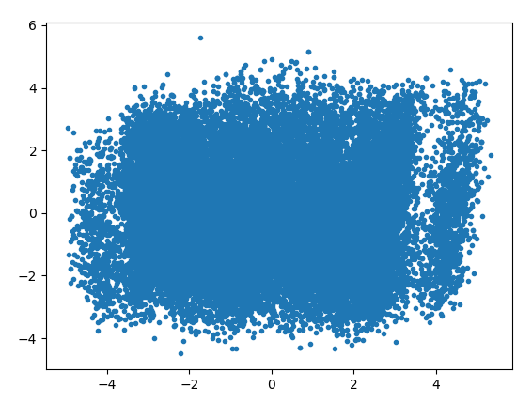
PCA Reduction of Vehicle Price Dataset
See VehiclePrice_PCA_1.py
Clustering is not very obvious

Slide 20
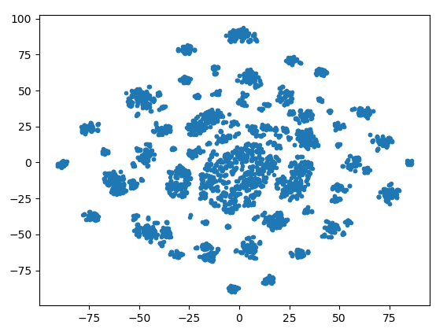
t-SNE Reduction of Vehicle Price Dataset
See VehiclePrice_tSNE_1.py
There appear to be lots of little clusters
This tends to happen with categorical data

Slide 21
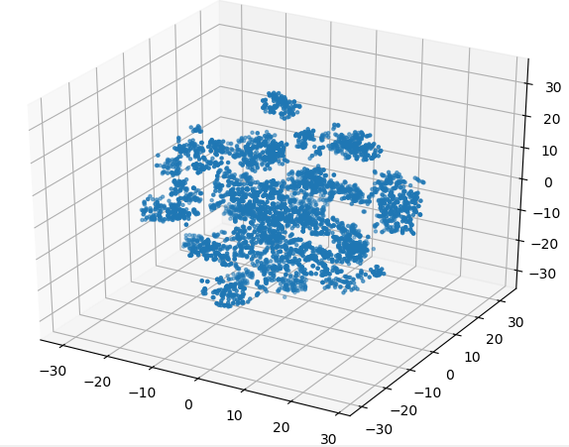
3D Visualization of t-SNE Reduction of Vehicle Price Dataset
See VehiclePrice_tSNE_2.py
Or VehiclePrice_tSNE_2b.py
The clusters can be seen more clearly in the 3D plot

Slide 22
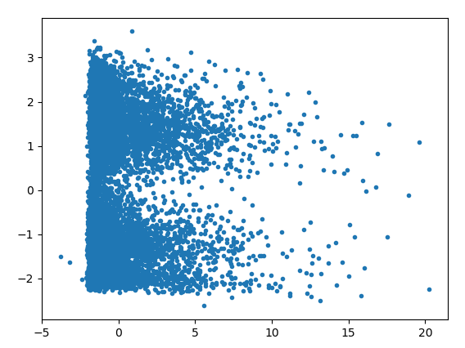
PCA Reduction of Credit Default Dataset
See CreditDefault_PCA_1.py
Again, clustering is not very obvious with this reduction

Slide 23
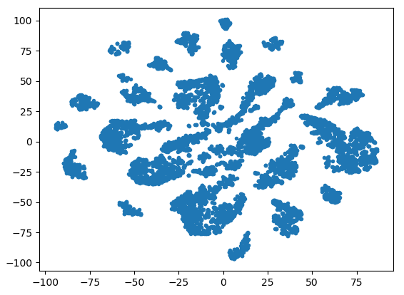
t-SNE Reduction of Credit Default Dataset
See CreditDefault_tSNE_1.py
There also appear to be lots of small clusters
This is common in categorial datasets

Slide 24
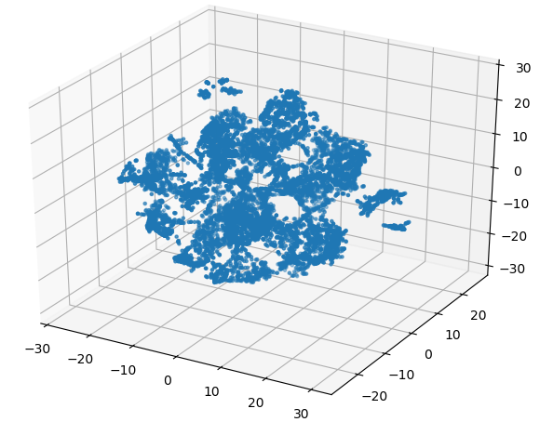
3D Visualization of t-SNE Reduction of Credit Default Dataset
See CreditDefault_tSNE_2.py
Or CreditDefault_tSNE_2b.py
We can clearly see the clusters in the visualization

Slide 25
Other Dimensionality Reduction Techniques
Kernel PCA
SVD
Random projection
Isometric mapping (Isomap)
Multidimensional scaling (MDS)
Local linear embedding (LLE)
Dictionary learning
Independent component analysis (ICA)

Slide 26
Clustering

Slide 27
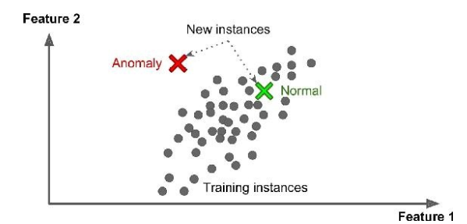
Clustering
Tries to find groups of data samples that are similar with respect to their features
Applications:
Automatic segmentation of data
Outlier detection
Detecting anomalous behavior (i.e. fraud, bots)
Data compression

Slide 28
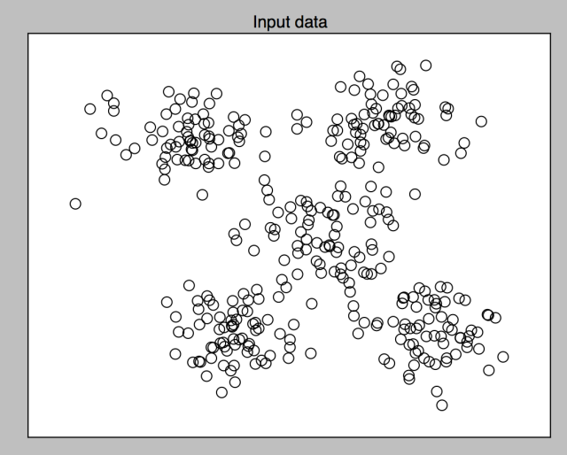
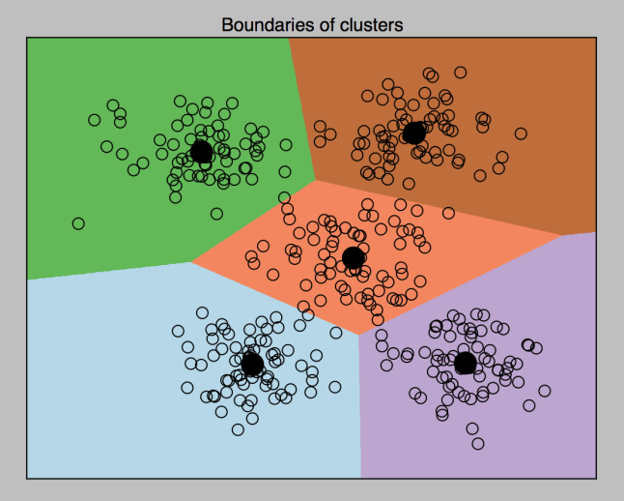
k-Means
The most commonly used clustering method
An iterative algorithm that automatically finds clusters in unlabeled data
You need to specify the number of clusters
The algorithm finds the best assignment of data samples to clusters

Slide 29
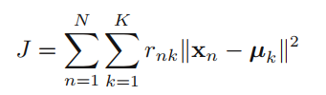
k-Means
Step 1: Start with a random centroid for each cluster
Step 2: Assign each sample to the nearest centroid
Using Euclidean distance
Step 3: Re-compute the centroid of each cluster based on the samples assigned to it
Step 4: Repeat steps 2 & 3 until there are no more reassignments
Or until a maximum number of iterations has been reached

Slide 30
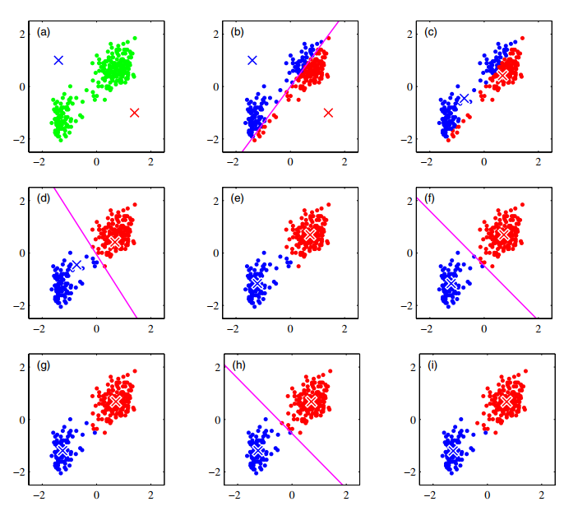
k-Means

Slide 31
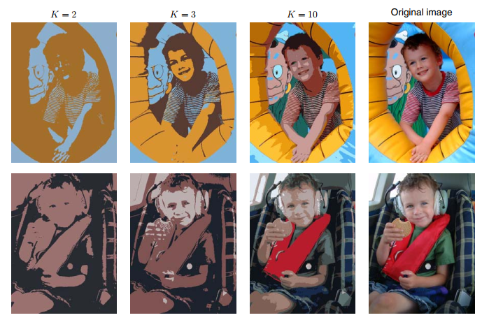
K-Means for Color Reduction in Images
A common application of k-Means is reducing the number of colors in an image

Slide 32
k-Means Considerations
It is important that all input features have the same scale
Standardizing the scale is necessary
It does not work directly with categorical features
It can be made to work if they get one-hot encoded
It may be more appropriate to use other clustering methods for categorical or mixed data
k-Modes, k-Prototypes, ROCK, etc.

Slide 33
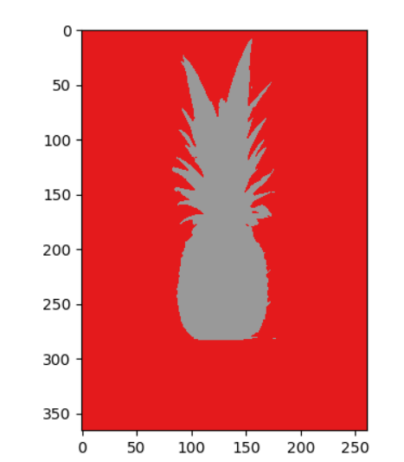
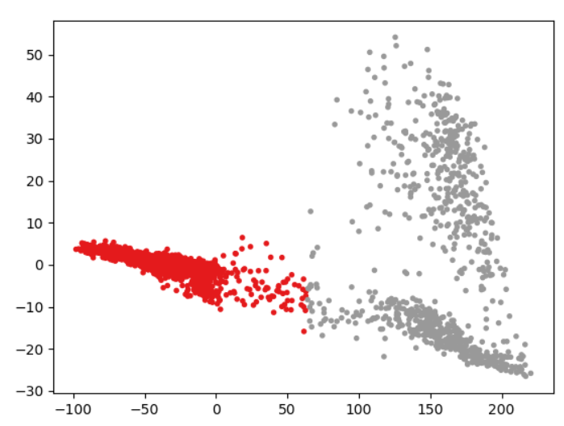
k-Means Clustering of Pineapple Image Colors
See Pineapple_Kmeans_1.py
With k=2:

Slide 34
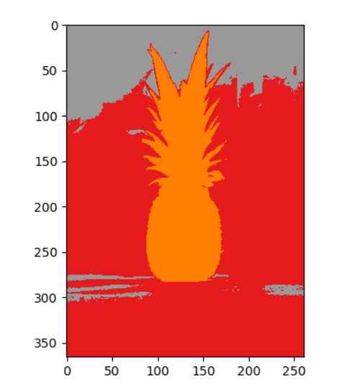
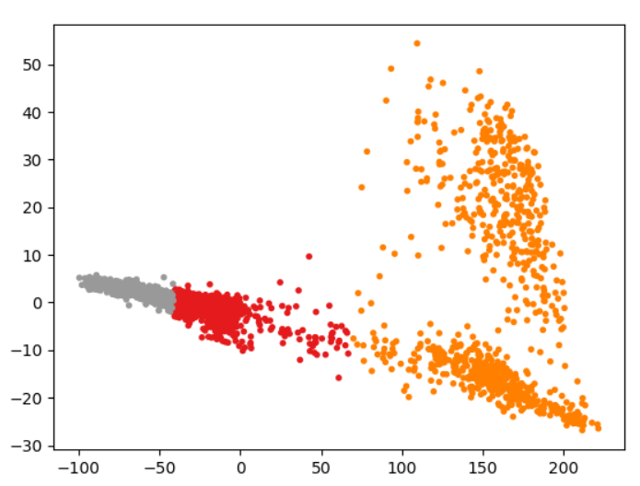
k-Means Clustering of Pineapple Image Colors
With k=3:

Slide 35
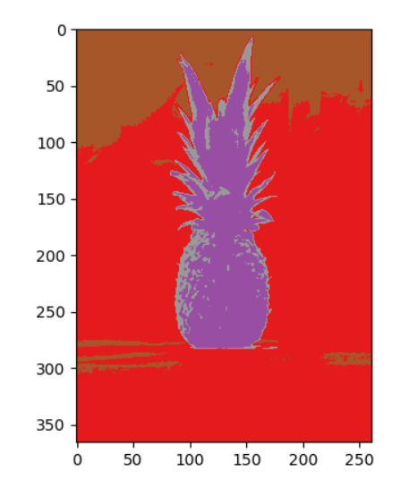
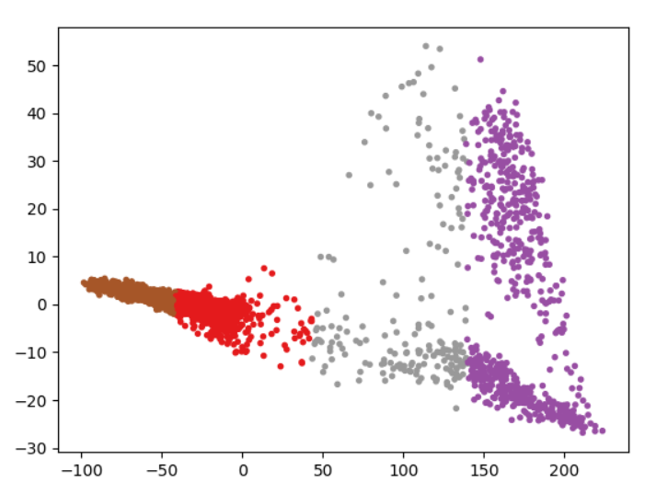
k-Means Clustering of Pineapple Image Colors
With k=4:

Slide 36
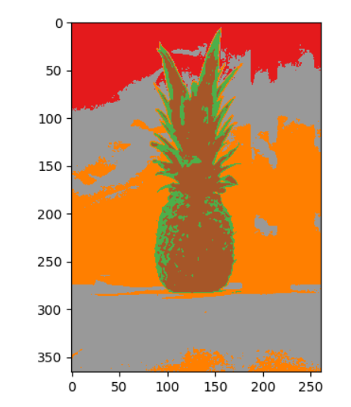
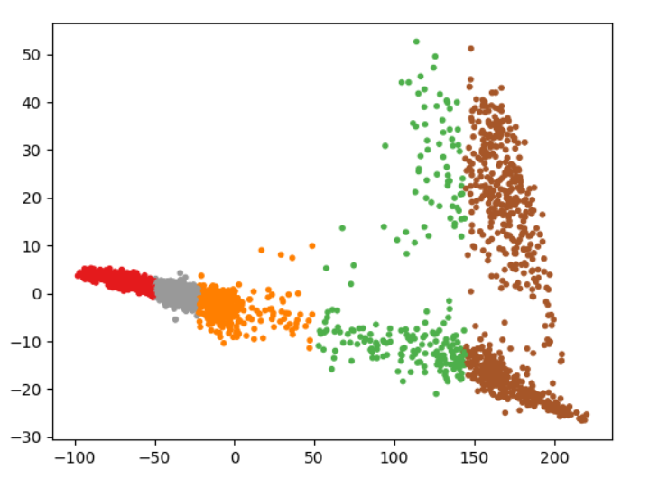
k-Means Clustering of Pineapple Image Colors
With k=5:

Slide 37
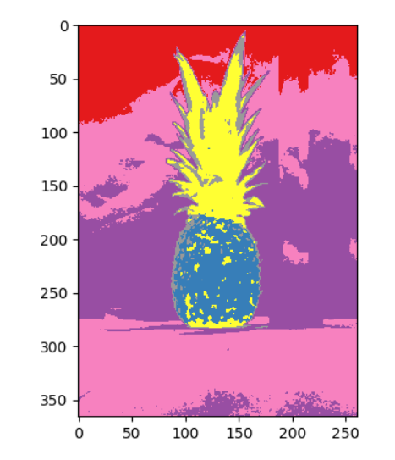
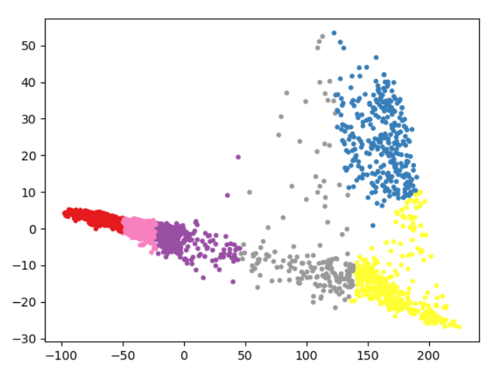
k-Means Clustering of Pineapple Image Colors
With k=6:

Slide 38
k-Means Clustering of MNIST
We use k-Means to perform clustering
Then we use t-SNE to view the results
See MNIST_Kmeans_1.py

Slide 39
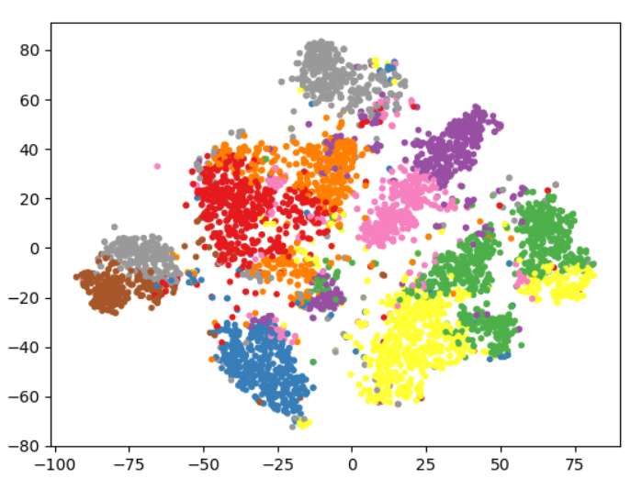
k-Means Clustering of MNIST
With k=10:

Slide 40
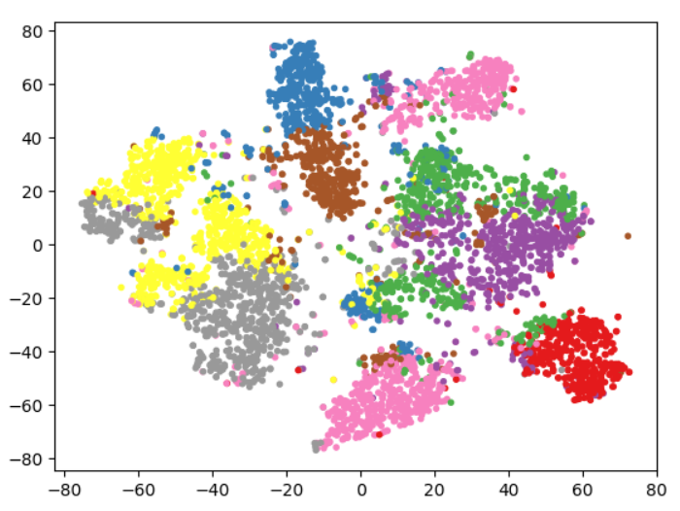
k-Means Clustering of MNIST
With k=8:

Slide 41
Viewing MNIST Cluster Centroids
We can visualize the cluster results by computing the cluster centroids and displaying them as images
See MNIST_Kmeans_2.py

Slide 42
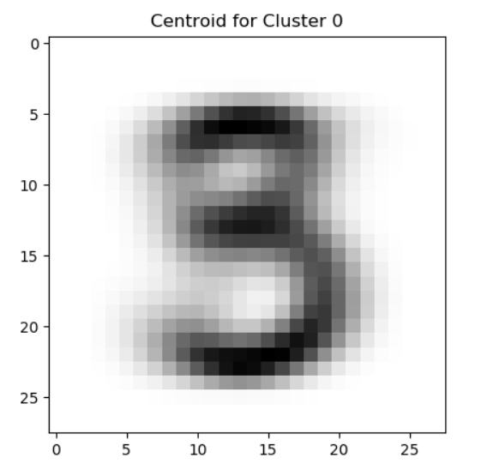
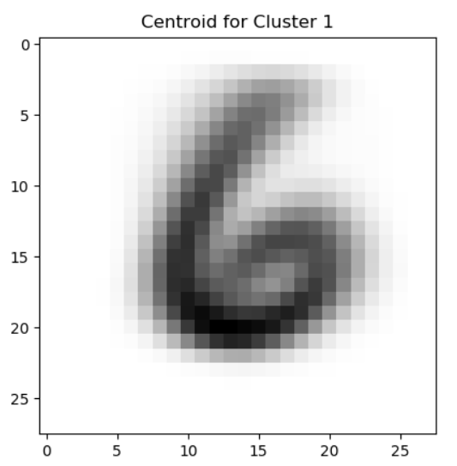
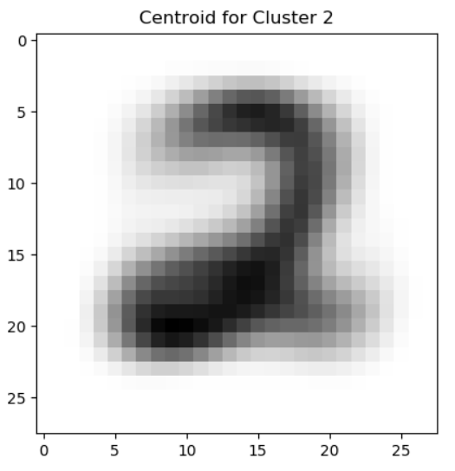
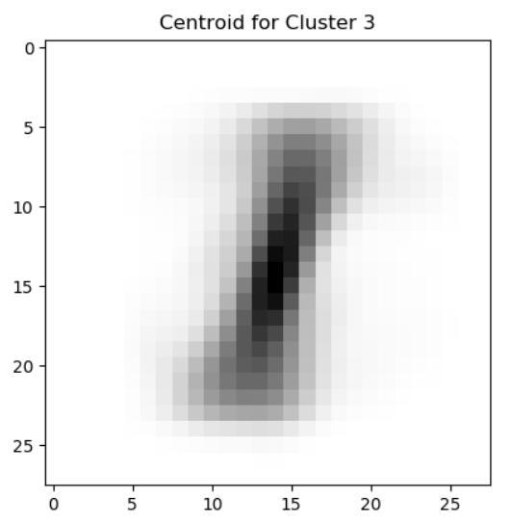
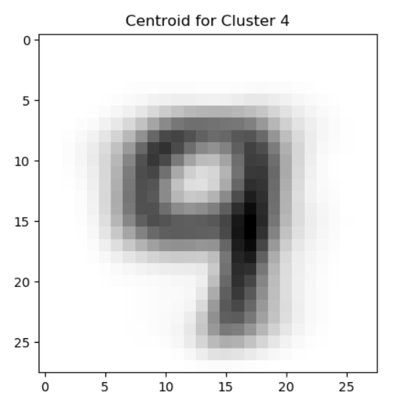
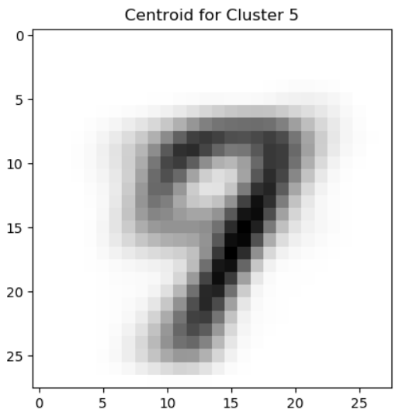
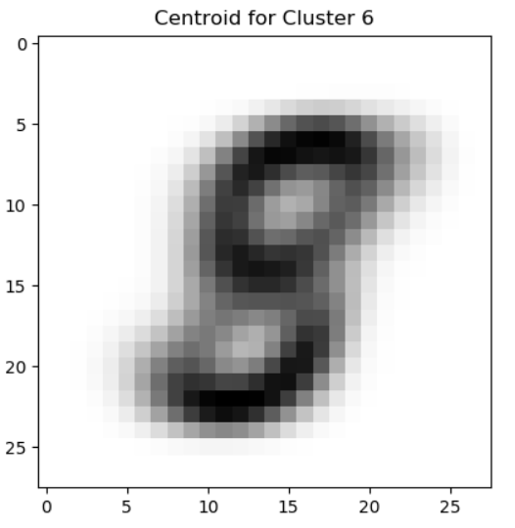
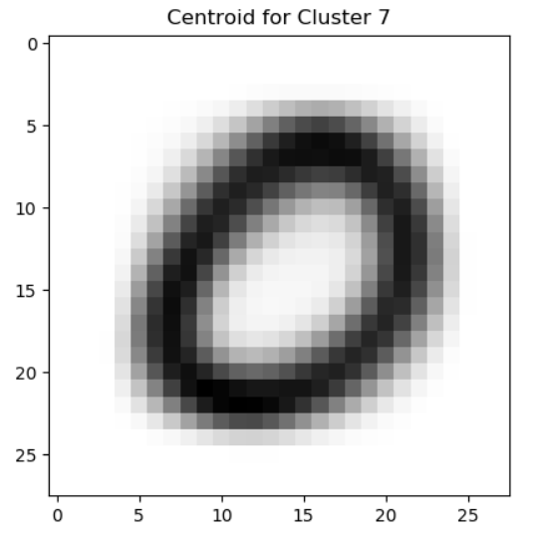
Viewing MNIST Cluster Centroids
With k=8:

Slide 43
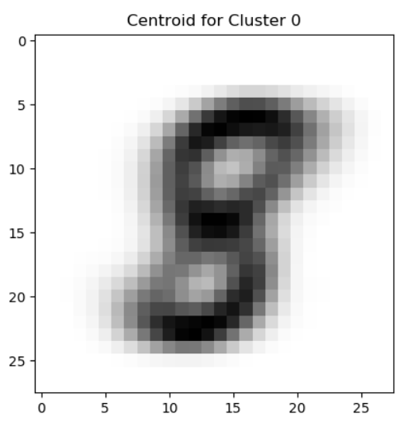


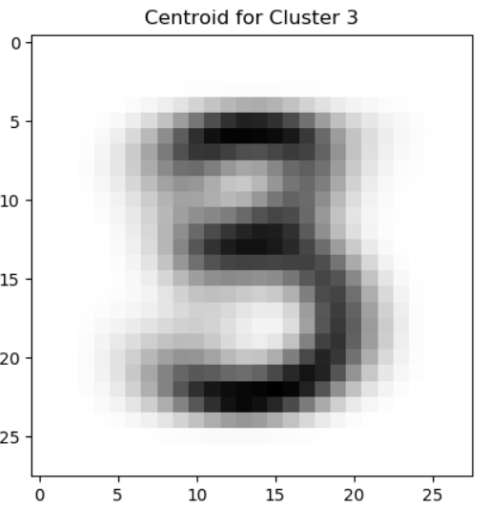

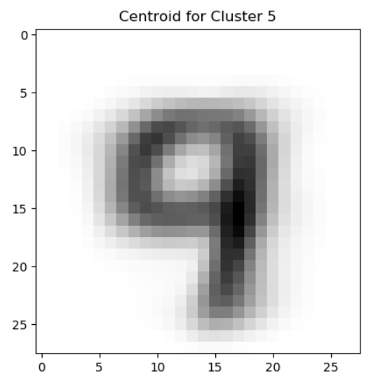
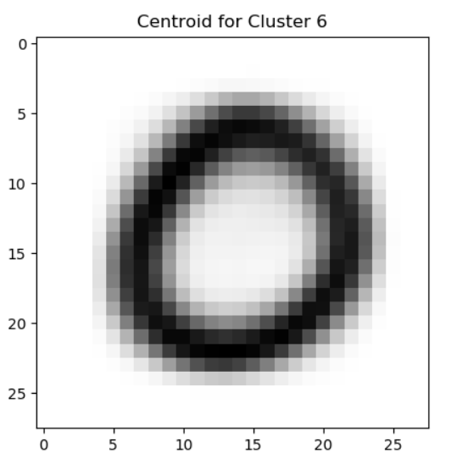
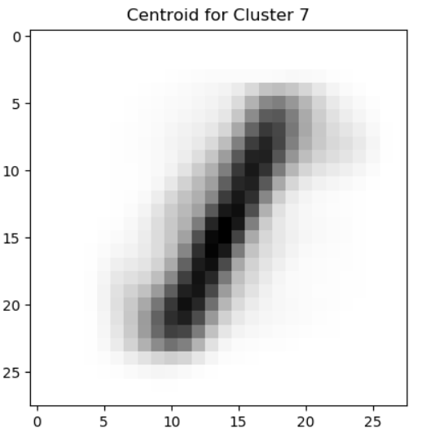


Viewing MNIST Cluster Centroids
With k=10:

Slide 44
k-Means Clustering of Vehicle Price Database
We use k-Means to compute cluster labels
We use t-SNE to visualize the cluster results
See VehiclePrice_Kmeans_1.py

Slide 45

k-Means Clustering of Vehicle Price Database
With k=10:

Slide 46

k-Means Clustering of Vehicle Price Database
With k=20:

Slide 47

k-Means Clustering of Vehicle Price Database
With k=30:

Slide 48
k-Means Clustering of Credit Default Database
We use k-Means to compute cluster labels
We use t-SNE to visualize the cluster results
See CreditDefault_Kmeans_1.py

Slide 49

k-Means Clustering of Credit Default Database
With k=10:

Slide 50

k-Means Clustering of Credit Default Database
With k=20:

Slide 51

k-Means Clustering of Credit Default Database
With k=50:

Slide 52
Evaluating the Number of Clusters
Aside from visual assessment
We can compute the average silhouette score of every sample in each cluster
The silhouette score is a measure of similarity among samples in each cluster, and also dissimilarity with respect to other clusters
Silhouette scores are expensive to compute
We need to limit to a random subset of the data

Slide 53

Silhouette Scores for MNIST
See MNIST_Kmeans_4.py
With k=10:

Slide 54

Silhouette Scores for MNIST
With k=8:

Slide 55
k-Means Silhouette Scores for MNIST
See MNIST_Kmeans_4b.py
K | Avg. Silhouette Score
2 | .088
3 | .052
4 | .061
5 | .067
6 | .066
7 | .066
8 | .072
9 | .057
10 | .059
11 | .059
12 | .058
15 | .063

Slide 56

k-Means Silhouette Scores for MNIST
See MNIST_Kmeans_4b.py
8 is the best number of clusters

Slide 57
k-Means Silhouette Scores for Vehicle Database
K | Avg. Silhouette Score
5 | .031
10 | .024
15 | .052
20 | .081
25 | .122
30 | .139
35 | .155
40 | .165
45 | .175
50 | .178
55 | .176
60 | .176
65 | .178
70 | .173
See VehiclePrice_Kmeans_2b.py

Slide 58

k-Means Silhouette Scores for Vehicle Database
About 50 clusters seem to be a good number
See VehiclePrice_Kmeans_2b.py

Slide 59

k-Means Clustering of Vehicle Price Database
With k=50:

Slide 60

Visualizing Cluster Characteristics for Vehicle Price Database
There are lots of clusters
We can pick a few with the best silhouette scores
See VehiclePrice_Kmeans_3.py
Pick a few clusters with high scores, and view
Histograms of numerical features
Bar graphs of categorical features

Slide 61







Visualizing Cluster Characteristics for Vehicle Price Database

Slide 62







Visualizing Cluster Characteristics for Vehicle Price Database

Slide 63







Visualizing Cluster Characteristics for Vehicle Price Database

Slide 64







Visualizing Cluster Characteristics for Vehicle Price Database

Slide 65







Visualizing Cluster Characteristics for Vehicle Price Database

Slide 66







Visualizing Cluster Characteristics for Vehicle Price Database

Slide 67







Visualizing Cluster Characteristics for Vehicle Price Database

Slide 68







Visualizing Cluster Characteristics for Vehicle Price Database

Slide 69
k-Means Silhouette Scores for Credit Default Database
K | Avg. Silhouette Score
5 | .155
10 | .212
15 | .248
20 | .255
25 | .274
30 | .274
35 | .266
40 | .296
45 | .274
50 | .271
55 | .277
60 | .270
65 | .266
70 | .259
See CreditDefault_Kmeans_2b.py

Slide 70

k-Means Silhouette Scores for Credit Default Database
About 40 clusters seem to be optimal
See CreditDefault_Kmeans_2b.py

Slide 71

k-Means Clustering of Credit Default Database
With k=40:

Slide 72

Visualizing Cluster Characteristics for Credit Default Database
We use k-Means to produce 40 clusters, and pick the ones with the best average silhouette score
See CreditDefault_Kmeans_3.py
We view their features
Histograms of numerical features
Bar graphs of categorical features

Slide 73







Visualizing Cluster Characteristics for Credit Default Database

Slide 74







Visualizing Cluster Characteristics for Credit Default Database

Slide 75







Visualizing Cluster Characteristics for Credit Default Database

Slide 76







Visualizing Cluster Characteristics for Credit Default Database

Slide 77







Visualizing Cluster Characteristics for Credit Default Database

Slide 78
Improving Clustering
One way to improve clustering performance is to perform clustering on dimensionality-reduced datasets
i.e. Perform PCA before k-Means
But don’t reduce to 2 or 3 dimensions
Keep 10-50, depending on the problem
It also helps speed-up the clustering

Slide 79
Other Clustering Methods
Hierarchical Cluster Analysis (HCA)
Gaussian mixture models (HMM)
Density-based spatial clustering of applications with noise (DBSCAN)

Slide 80
Other Unsupervised Learning Approaches
Anomaly Detection by Reconstruction
First perform dimensionality reduction (by PCA or others)
Then dimensionality expansion (reconstruction of the original data)
The reconstruction error points to outliers
Autoencoders
Use neural networks to reduce and then reconstruct the original data
A small bottleneck layer will learn a reduced representation of the data
Generative adversarial networks (GANs)
Generate new “fake” samples that resemble characteristics of the training set

Slide 81
Thank you

